Slide 1
Vorbis Codec (contd.) and Ogg Specifications and Decoding
By
Bharan, Kulin, Prasad and Sanjay

Slide 2
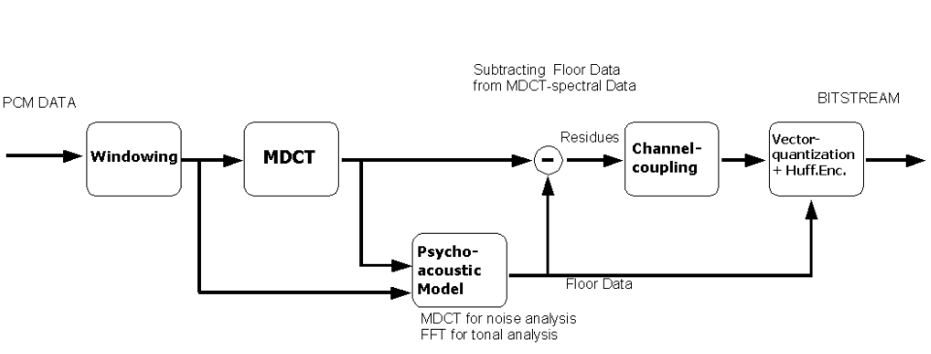
Vorbis audio codec

Slide 3
Floor
Low-resolution parts of audio spectrum
Number of floor types used and configurations specified in setup header
Floor type 0
  Floor 0 uses a packed LSP representation on a dB amplitude scale and Bark frequency scale
  Not known to be used except by beta4 of the reference encoder
Floor type 1
  Piecewise linear interpolated representation on a dB amplitude scale and linear frequency scale
  Easier to decode than type 0

Slide 4
Floor I
Floor type I → represents a spectral curve as a series of line segments
Example : The list of selected X values in increasing order is 0,16,32,48,64,80,96,112 and 128. In list order, the values interleave as 0, 128, 64, 32, 96, 16, 48, 80 and 112. The corresponding list-order Y values as decoded from an example packet are 110, 20, -5, -45, 0, -25, -10, 30 and -10. We compute the floor in the following way

Slide 5
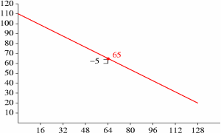
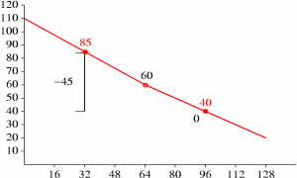
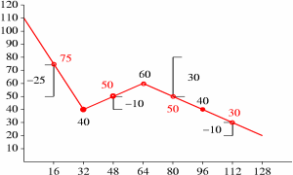
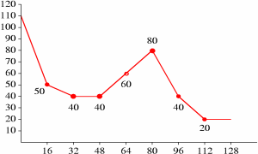
Beginning with the first line
corrected Y at x =64, iterate for X = 32 &96
New_Y for different X
Complete floor pattern

Slide 6
Residue
Residue = Spectrum - Floor
Number of residue types used and configurations stored in setup header
Type 0: VQ encoding is interlaced
Type 1: VQ encoding is not interlaced
Type 2: Several vectors are interlaced and then flattened

Slide 7
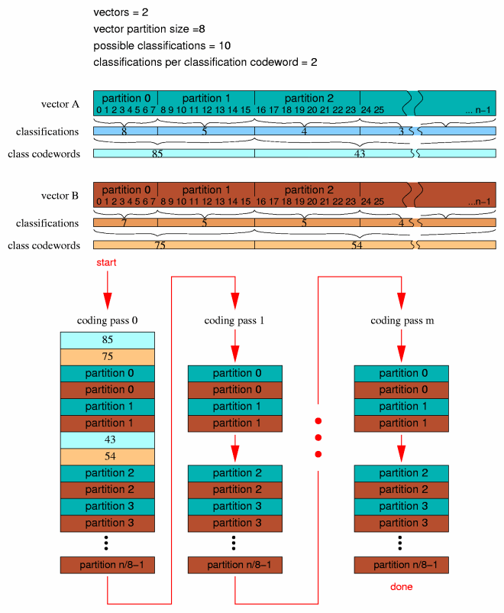
Residue 0

Slide 8
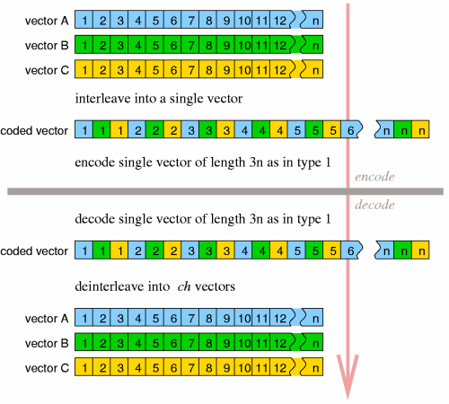
Residue 2

Slide 9
Vector quantization
Lookup type
  Type 0: no lookup
  Type 1: lattice VQ (mostly used)
  Type 2: tessellated VQ
No shared codebooks
  VQ codebooks and Huffman codes computed as part of encoding
  Codebooks stored at start of bitstream

Slide 10
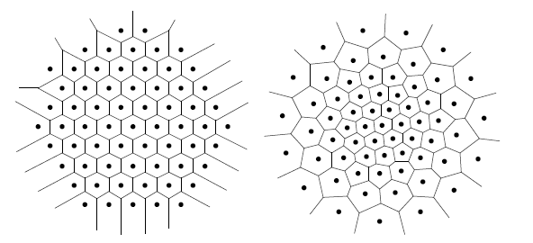
Lattice quantization
Lattice VQ is a constrained VQ technique,
where the code vectors form a highly regular
structure
The regular structure makes compact storage
Fast nearest-neighbor search (finding the
closest code vector to an input vector)

Slide 11
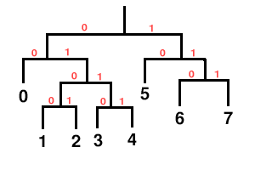
Huffman entropy encoding
The entropy coding in a Vorbis I codebook is provided by a standard Huffman binary tree representation

Slide 12
Mappings
Holds a channel coupling description
Mappings can be used to determine which vectors are used to decode which audio channels
Comprised of submaps
Each submap corresponds to a subset of the floor and residue vector configurations
Notes:
Used, for example, to interleave stereo audio
Left and right channel vectors are converted to a magnitude and angle vector

Slide 13
Modes
Master arm switch for packet coding
  A specific mode number identifies a specific configuration
    Transform used
    Frame size
    Mapping number
  This allows us to tweak how individual frames are coded
Mode configurations stored in setup header

Slide 14
Header packets
Identification header → Vorbis version number, Number of channels, Sample Rate
Comment header → Title, Version, Artist, Genre, Date, Copyright, etc.
Setup Header → The setup header contains, in order, the lists of codebook configurations, time-domain transform configurations, floor configurations, residue configurations, channel mapping configurations and mode configurations
Notes:
All three must appear and in this order.

Slide 15
Audio packets
Type flag
Mode number
Window shape
Floor (ordered by channel)
Residue (ordered by submap)
Notes:
Since frames can be one of two sizes, the window shape has to be determined first for overlap and second for the inverse MDCT.

Slide 16
Vorbis decoding
Start
Decode packet type flag
Decode Mode
Number
Decode window
Shape
Overlap/add left-hand output of transform with right-hand output of previous frame
Decode Floor
Decode residue into residue vectors
Store right hand data from transform of current frame for future lapping
Inverse channel coupling of residue vectors
Is this first frame?
No
Generate floor curve from decoded floor data
Compute dot product of floor and residue, producing audio spectrum vector.
Yes
Inverse monolithic transform of audio spectrum vector, always an MDCT in Vorbis I
Continue

Slide 17
Ogg encapsulation
Octet vectors of raw, compressed data or packets - no boundary info
To provide framing/sync, sync recapture after error, landmarks during seeking, and enough info to separate data back into packets at orig. packet boundaries, without relying on decoding to find the packet boundaries

Slide 18
Ogg encapsulation
Logical and physical
Decode single pages at a time from the overall bitstream
Logical – contiguous stream of seq. pages belonging to a single codec instance
Physical – composed of multi. Logical bitstreams – simplest is the degenerate bitstream
Example: Vorbis audio, Tarken Video

Slide 19
Design constraints
True streaming
No more than 1-2% of bitstream bandwidth
Abs. position within original stream
Limited editing, simplified concatenation mechanism
Detect corruption, frame sync, random access to data at arbitrary positions

Slide 20
Bitstream structure
Packet segmentation – lacing values.
Packet can span multiple pages, though individual segments cannot
Avoids a max. packet size
Nominal page size of 4-8 kB recommended
Encoding looks odd, but is properly optimized for speed – various sizes can be handled

Slide 21
Page format
Capture pattern (0-3)
Stream structure version (4)
Header type flag (5)
Absolute granular position (6-13) – little endian – a truncated stream will also work (wow!)
Stream serial no. (14-17)
Page sequence no. (18-21)

Slide 22
Page format
32-bit CRC checksum (22-25)
  direct algorithm, initial value and final XOR = 0, generator polynomial=0x04c11db7
Page_segments (26)
Segment_table (containing the packet lacing values)

Slide 23
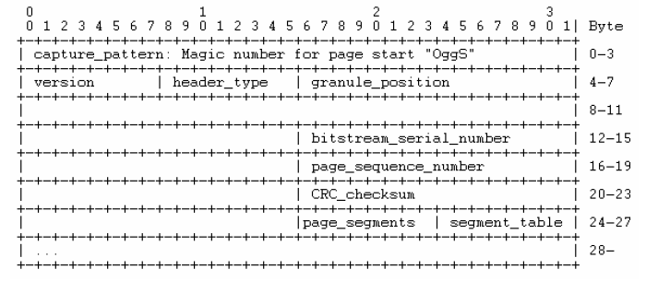
Page format

Slide 24
Additional end-to-end structure
BOS
EOS
First page – contains initial header packet – codec type recognition
  Vorbis places name and rev. of the codec, audio rate and audio quality

Slide 25
Ogg multiplexing
Chaining (sequential) – used in Ogg Vorbis
Concurrent (grouped)
  Initial pages must appear together
Mixed (combo of the prev. two)

Slide 26
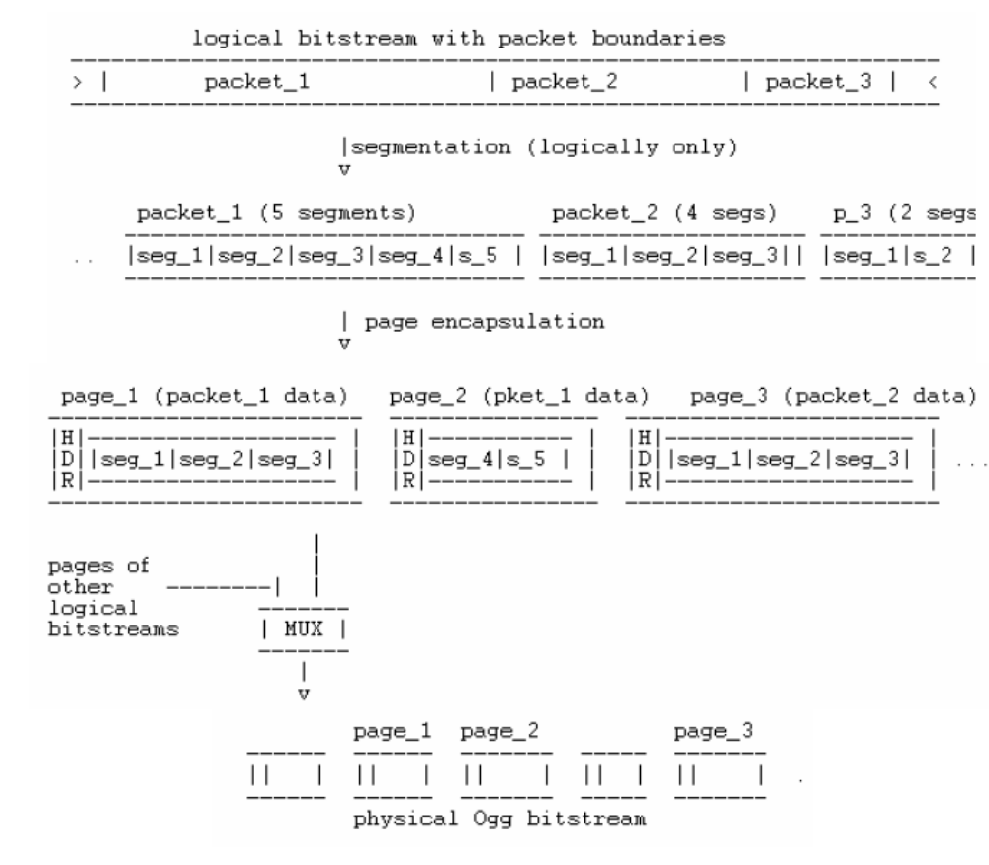

Slide 27
Ogg decoding
Start
Framing incoming bit stream into pages
Sort and buffer into logical bit stream
Decompose into raw segments
Reconstruct segments
Reconstruct packet and pass to vorbis layer
Stop

Slide 28
That’s all folks
Questions?

